Slide 1
Level 6 Group 9 Pitch 4
Thomas Simmons, Quwaine Dantes - McPherson, Callam Mutton

Slide 2
Summary of Brief
What we want to player to feel is Fiero and a zen like focus.
Through the of lesser used mechanics in platformers, we want to create a game that wont be considered another platformer clone/ generic platformer.
Create a user experience that challenges the player as well as immerses them into the game though the gameplay rather than the narrative.
QD

Slide 3
Target Audience/Demographic
49% of casual players aged 25-34 spend money on mobile games
13-17 year old gamers play games for longer durations at once
54% of casual players aged 13-24 don’t spend money on games but spend more time playing the game.
46% of mobile gamers worldwide play casual/social games.
Target Audience is 12 to 25 year old male and female gamers
TS

Slide 4
Game Idea
The player controls the character and must avoid samurai birds and spiders, in order to retrieve the key to unlock the area that his fellow villagers are being held.
If the player is seen by either the bird or spider they have to reach an checkpoint in the map before the enemy does to avoid being alerted of their presence
The player has the ability to use a grapple hook to help get across the map faster.
TS

Slide 5
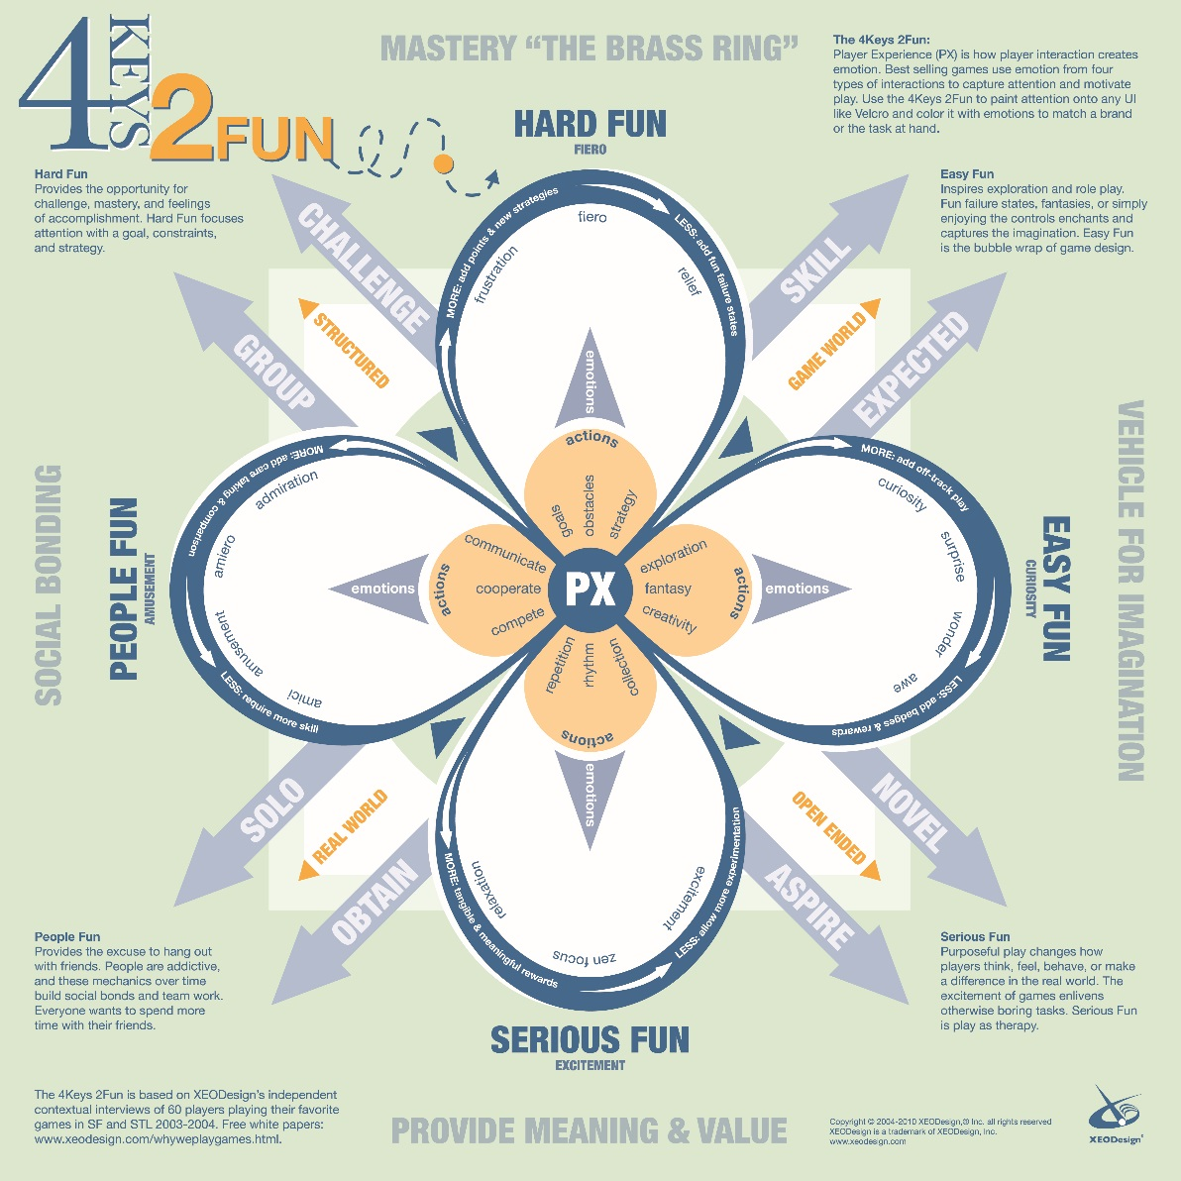
Keys of Fun
We will want to implement the following
Hard Fun: Fiero, Frustration, Relief
Easy Fun: Exploration, Surprise
Serious Fun: Zen Focus
QD

Slide 6
Level Design Loop
Explore
Stealth
Collect
CM

Slide 7
Gameplay Loop
Stealth
Assassinate
Rescue
CM

Slide 8
Player Reward
Players throughout the level can collect ninja stars which will contribute to the players final score at the end of each level.
CM

Slide 9
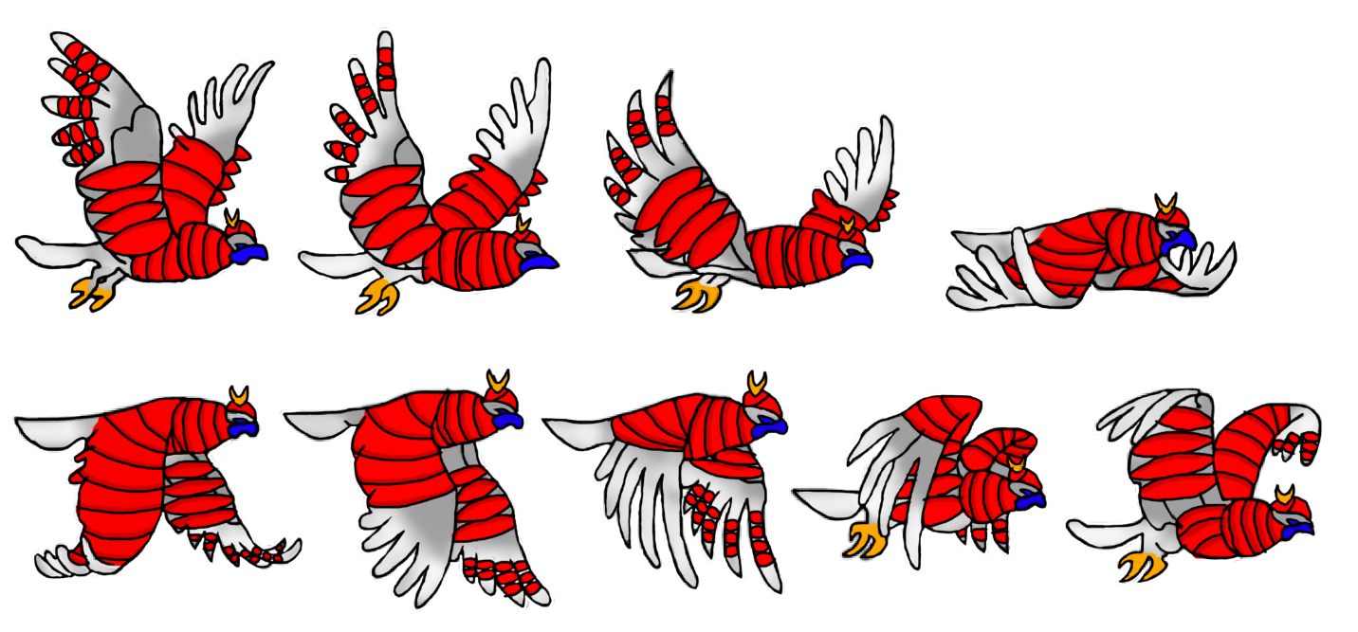
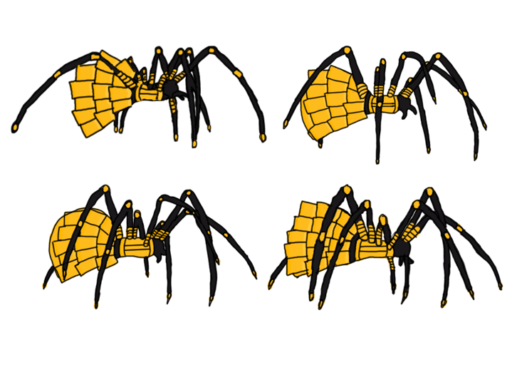
Character Artwork
TS

Slide 10

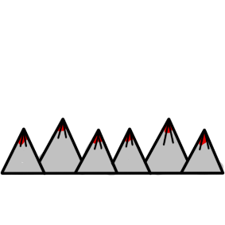

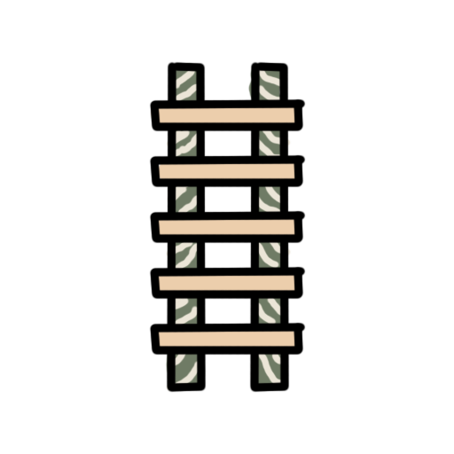


Props & Platformer Artwork

Slide 11
Any Questions?

